Slide 1
No Calling Out
What does it look like?
What does it sound like?
What does it feel like?

Slide 2
Respect our Whiteboard and Markers
What does it look like?
What does it sound like?
What does it feel like?

Slide 3
Daily Review
Physical adaptations are physical features that help an organism to survive in its environment
Behavioural adaptations are things an organisms does (behaviours) that help it survive in its environment.
Look at the picture of the kookaburra and some of its adaptations on the next slide. Classify each adaptation as physical or behavioural.

Slide 4
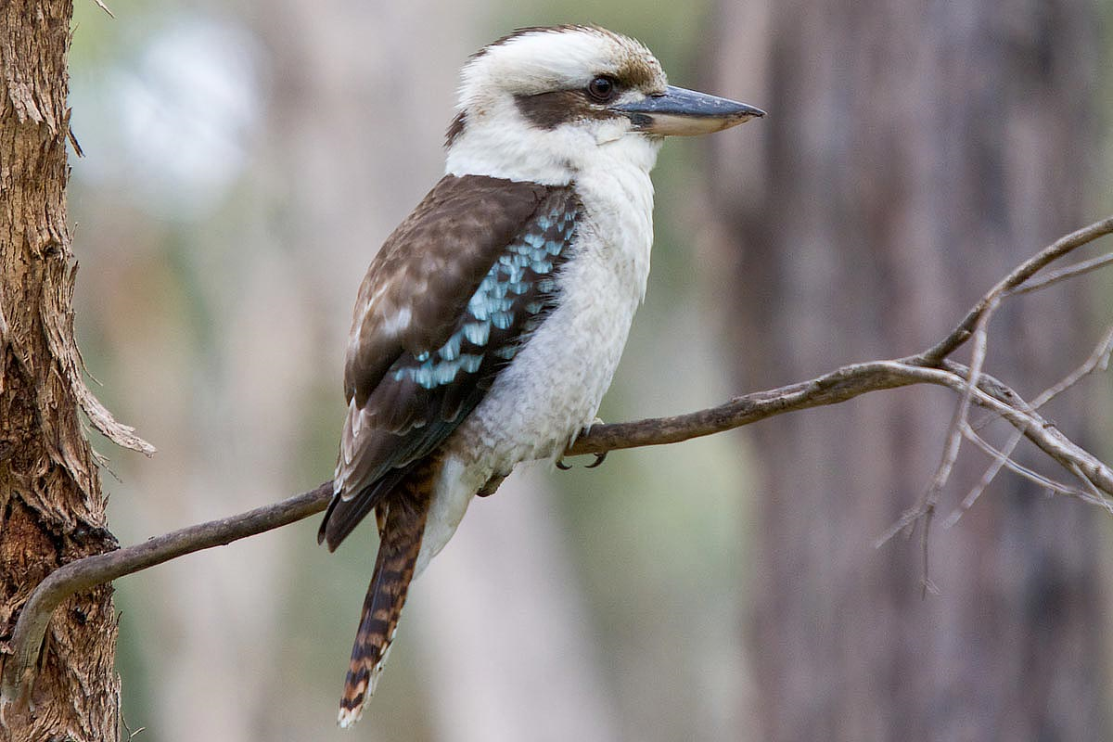
Daily Review
Able to keep still
When the kookaburra waits for prey, they can keep perfectly still, so their prey doesn’t notice
Strong beak
Helps the kookaburra catch prey and build its nest
Colour
Kookaburras need to hide in trees so that their prey doesn’t see them
Laughing call
Helps the kookaburra communicate with each other and mark territory boundaries

Slide 5
Design an Animal Presentation

Slide 6
Speech Structure
Your speech should have a structure
Introduce your animal
Your animal’s habitat
Physical adaptations
Behavioural adaptations
Human activities
Each part should be written as a paragraph

Slide 7
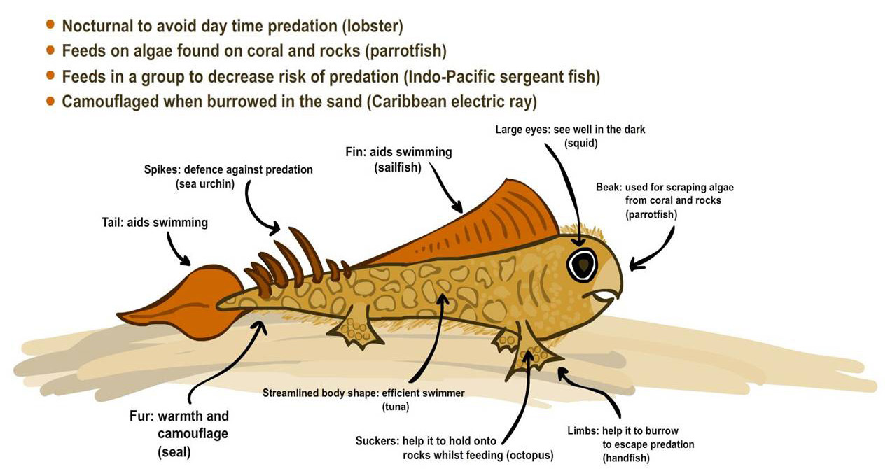
Speech Structure
Your speech should have a structure
Introduce your animal: Tell your audience the name of your animal and basic facts about it, for example its size, colour and food sources
The animal I have created is called the Spiny Skipper. When fully grown, it is between 20 to 30 centimetres long. The body of the Spiny Skipper is light brown and it has an orange tail and fin. The Spiny Skipper eats algae found on rocks and coral.

Slide 8
Speech Structure
Your speech should have a structure
Your animal’s habitat: Where your animal lives, the conditions in the habitat, for example what the temperature/weather is like, competition for food/water etc.
The Spiny Skipper lives in coral reefs. In the shallow parts of the reef, the water can be warm, with a lot of sunlight during the day. There are lots of fish in the coral reef competing with the Spiny Skipper for the algae. There are also many animals hunting the Spiny Skipper.

Slide 9
Speech Structure
Your speech should have a structure
Physical adaptations: Describe at least three of its physical adaptations, the function of the adaptation and what animal it originally comes from
One physical adaptation of the Spiny Skipper are the suckers on its feet. These are used to hold onto rocks while it is feeding, similar to the suckers on an octopus’ tentacles. The Spiny Skipper also has spikes on its tail, like a sea urchin. The spikes are used to defend itself from predators. A third physical adaptation of the Spiny Skipper is its beak. The beak is used to scrape algae off the rocks and coral, like a parrotfish.

Slide 10
Speech Structure
Your speech should have a structure
Behavioural adaptations: Describe at least two behavioural adaptations of your animal, explain why your animal does that behaviour and another animal that has the same behaviour
A behavioural adaptation of the Spiny Skipper is that it is nocturnal. Lobsters are also nocturnal and being a nocturnal animal helps them avoid daytime predators. The Spiny Skipper also buries itself in the sand to camouflage itself. An animal that also buries itself as camouflage is the electric ray.

Slide 11
Speech Structure
Your speech should have a structure
Human activities: Describe one way humans might impact your animal in its habitat, for example pollution, deforestation or hunting it for fur/other body parts
Since the Spiny Skipper is an ocean animal, it would be affected by human rubbish polluting the oceans. It would also be affected by oil spills and tourism on the coral reefs.

Slide 12
Speech Structure
Your speech should have a structure
Introduce your animal: Tell your audience the name of your animal and basic facts about it, for example its size, colour and food sources
Your animals’ habitat: Where your animal lives, the conditions in the habitat, for example what the temperature/weather is like, competition for food/water etc.
Physical adaptations: Describe at least three of its physical adaptations, the function of the adaptation and what animal it originally comes from
Behavioural adaptations: Describe at least two behavioural adaptations of your animal, explain why your animal does that behaviour and another animal that has the same behaviour
Human activities: Describe one way humans might impact your animal in its habitat, for example pollution, deforestation or hunting it for fur/other body parts

